Slide 1
Tree

Slide 2
TREE - PART 1
Definition
Terminologies
Depth and Height

Slide 3
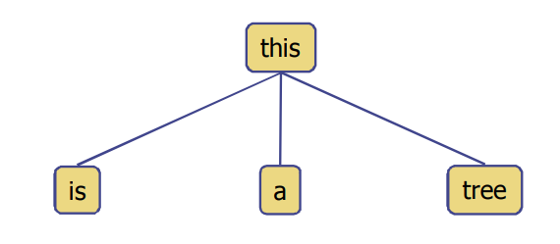
What is a Tree?
A connected acyclic graph is a tree.
In computer science, a tree is an abstract model of a hierarchical structure.
A tree consists of nodes with a parent-child relationship
Applications:
Organizational charts
File systems
Programming environments

Slide 4
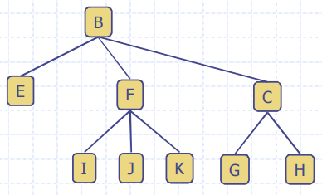
What is a Tree? (Cont.)
A tree T is a set of nodes in a parent-child relationship with the following properties:
T has a special node r, called the root of T, with no parent node
Each node v of T, different from r, has a parent node u

Slide 5
Tree Terminologies
Root: node without parent (A)
Internal node: node with at least one child (A, B, C, F)
External node (Leaf ): node without children (E, I, J, K, G, H, D)
Ancestors of a node: parent, grandparent, grand-grandparent, etc.
Descendants of a node: child, grandchild, grand-grandchild, etc.
Depth of a node: number of ancestors, excluding the node itself
Height of a tree: maximum depth of any node
Siblings: two nodes that are children of the same parent
A
B
C
D
E
F
G
H
I
J
K

Slide 6
Note
We will explore the implementation codes for Trees later on
For now lets us get some general idea about some tree related algorithms

Slide 7
Depth and Height of a Node
The depth of a node v can be recursively defined as follows
If v is the root, then the depth of v is 0.
Otherwise, the depth of v is one plus the depth of the parent of v
Algorithm depth(T, v)
if T.isRoot(v) then
return 0
else
return 1 + depth(T, T.parent(v))

Slide 8
Depth and Height of a Node
The height of a node v can be recursively defined as follows
If v is a leaf node, then the height of v is 0.
Otherwise, the height of v is one plus the maximum height of a child of v The height of a tree T is the height of the root of T The height of a tree T is equal to the maximum depth of a leaf node of T
Algorithm height(T, v)
if T.isLeaf(v) then
return 0
else
h = 0
for each w ε T.children(v) do
h = max(h, height(T, w))
return 1 + h

Slide 9
TREE - PART 2
Ordered Trees
Tree Traversal

Slide 10
Ordered Trees
A tree is ordered if there is a linear ordering defined for each child of each node.
A binary tree is an ordered tree in which every node has at most two children.
If each node of a tree has either zero or two children, the tree is called a proper binary tree.

Slide 11
Ordered Trees
A tree is ordered if there is a linear ordering defined for each child of each node.
A binary tree is an ordered tree in which every node has at most two children.
If each node of a tree has either zero or two children, the tree is called a proper binary tree.
A
B
C
D
E
F
G
H
I
J
K
What happens if it is an ordered tree?
vs
What happens if it is not an ordered tree?

Slide 12
Ordered Trees
A tree is ordered if there is a linear ordering defined for each child of each node.
A binary tree is an ordered tree in which every node has at most two children.
If each node of a tree has either zero or two children, the tree is called a proper binary tree.

Slide 13
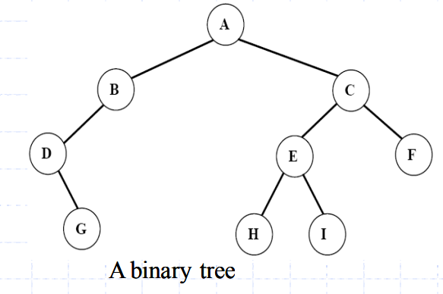
Ordered Trees
A tree is ordered if there is a linear ordering defined for each child of each node.
A binary tree is an ordered tree in which every node has at most two children.
If each node of a tree has either zero or two children, the tree is called a proper binary tree.
Recall the term m-ary tree

Slide 14
Ordered Trees
A tree is ordered if there is a linear ordering defined for each child of each node.
A binary tree is an ordered tree in which every node has at most two children.
If each node of a tree has either zero or two children, the tree is called a proper binary tree.

Slide 15
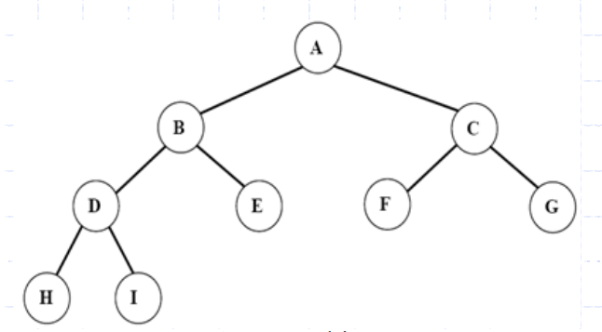
Ordered Trees
A tree is ordered if there is a linear ordering defined for each child of each node.
A binary tree is an ordered tree in which every node has at most two children.
If each node of a tree has either zero or two children, the tree is called a proper binary tree.
Recall the term proper m-ary tree

Slide 16
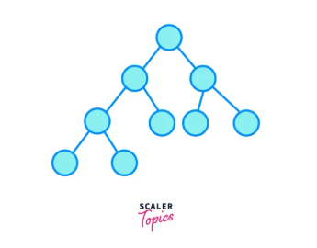
Ordered Trees
Complete - All levels full except possibly last; last filled left to right
Perfect - Proper + all leaves at same level + all levels filled.
Complete Binary Tree

Slide 17
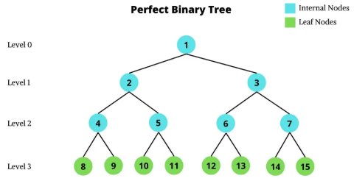
Ordered Trees
Complete - All levels full except possibly last; last filled left to right
Perfect - Proper + all leaves at same level + all levels filled.
Complete Binary Tree

Slide 18
Tree Traversal
A traversal of a tree T is a systematic way of visiting all the nodes of T
Traversing a tree involves visiting the root and traversing its subtrees
There are the following traversal methods:
Preorder Traversal
Postorder Traversal
Inorder Traversal

Slide 19
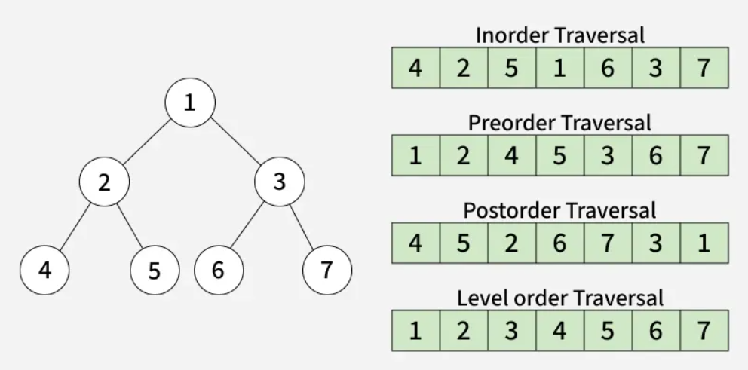
Tree Traversal

Slide 20
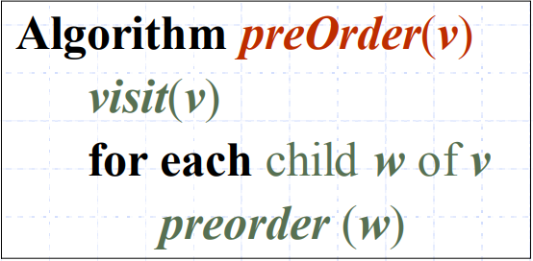
Tree Traversal
Preorder Traversal (General Tree)
In a preorder traversal, a node is visited before its descendants.
If a tree is ordered, then the subtrees are traversed according to the order of the children

Slide 21
Tree Traversal
Preorder Traversal (Binary Tree)
Visit the root.
Traverse the left subtree in Preorder.
Traverse the right subtree in Preorder.

Slide 22
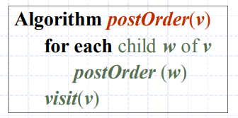
Tree Traversal
Postorder Traversal (General Tree)
In a postorder traversal, a node is visited after its descendants

Slide 23
Tree Traversal
Postorder Traversal (Binary Tree)
Traverse the left subtree in Preorder.
Traverse the right subtree in Preorder.
Visit the root.

Slide 24
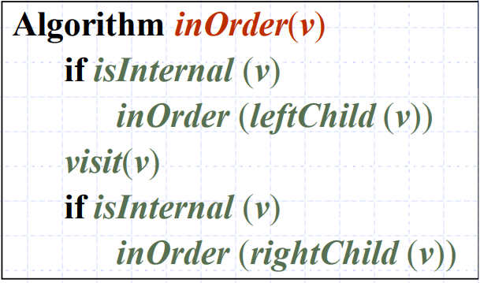
Tree Traversal
Inorder Traversal (General Tree)
In an inorder traversal a node is visited after its left subtree and before its right subtree

Slide 25
Tree Traversal
Inorder Traversal (Binary Tree)
Traverse the left subtree in inorder.
Visit the root.
Traverse the right subtree in inorder.

Slide 26
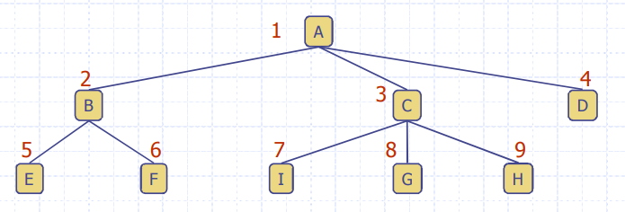
Level Order Tree Traversal
In a level order traversal, every node on a level is visited before going to a lower level
Level order: A B C D E F I G H

Slide 27
A Property of Proper Binary Trees
A (proper) binary tree is a tree with the following properties:
Each internal node has two children
The children of a node are an ordered pair
In a (proper) binary tree T, the number of external nodes is 1 more than the number of internal nodes.
Proof:
Use Induction

Slide 28
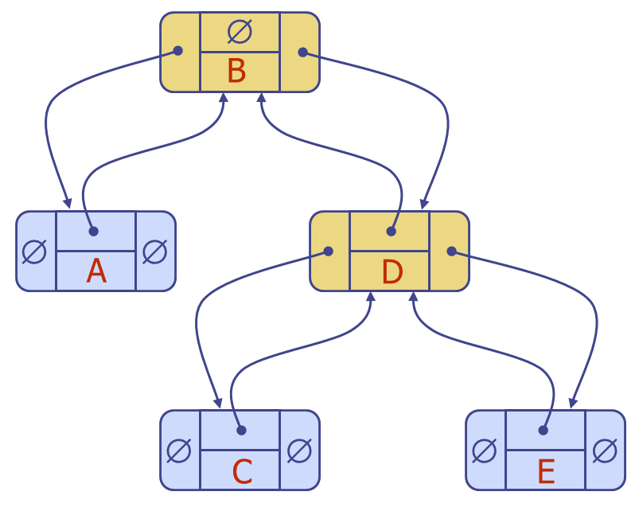
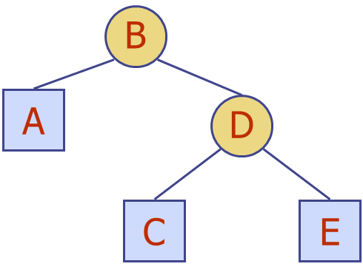
Implementing Binary Trees
struct TreeNode{
int value;
struct TreeNode* parent;
struct TreeNode* left;
struct TreeNode * right;
}

Slide 29
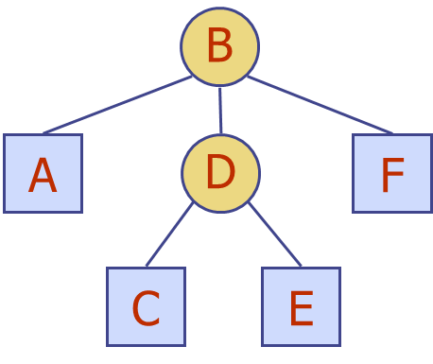
Implementing General Trees
struct Container{
struct TreeNode* childrenArr[7];
int noOfChildren;
}
noOfChildren
B
∅
struct TreeNode{
int value;
struct TreeNode* parent;
struct Container* childrenContainer;
}
A
∅
D
F
∅
noOfChildren
C
∅
E
∅

Slide 30
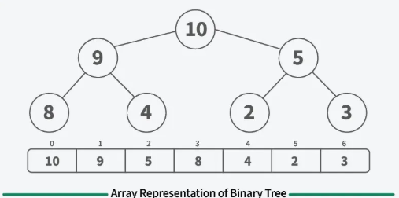
Implementing Binary trees using array
Complete/Perfect Binary Tree:
If a node is at index i:
Left child → 2i + 1
Right child → 2i + 2
Parent → (i - 1) // 2

Slide 31
Drawing Trees based on Tree Traversals
Pre Order and Inorder
Pre-Order : 1, 2, 4, 8, 9, 10, 11, 5 ,3, 6, 7
In-Order : 8, 4, 10, 9, 11, 2, 5, 1, 6, 3, 7
Method:
Consider the In Order Sequence.
Identify the Root (first element from pre order) and draw it.
Determine left in order sequence and right in order sequence
Repeat until the tree is drawn

Slide 32
Drawing Trees based on Tree Traversals
Post Order and Inorder
Pre-Order : 9, 1, 2, 12, 7, 5, 3, 11, 4, 8
In-Order : 9, 5, 1, 7, 2, 12, 8, 4, 3, 11
Method:
Consider the In Order Sequence.
Identify the Root (last element from pre order) and draw it.
Determine left in order sequence and right in order sequence
Repeat until the tree is drawn

Slide 33
Drawing Trees based on Tree Traversals
Pre Order and Post Order
Pre-Order : F, B, A, D, C, E, G, I, H (Root, Left, Right)
Post-Order : A, C, E, D, B, H, I, G, F (Left, Root, Right)
Method:
Consider the Post Order Sequence.
Identify the Root (with the help of pre-order).
Identify the partitioning element (Second Element after Root in preorder).
Partition the Post Order Sequence to obtain two more post order sequences.
Repeat until the entire tree is drawn.

Slide 34
Thank You

